Slide 1
Battery Framework
Vojtech Krs

Slide 2
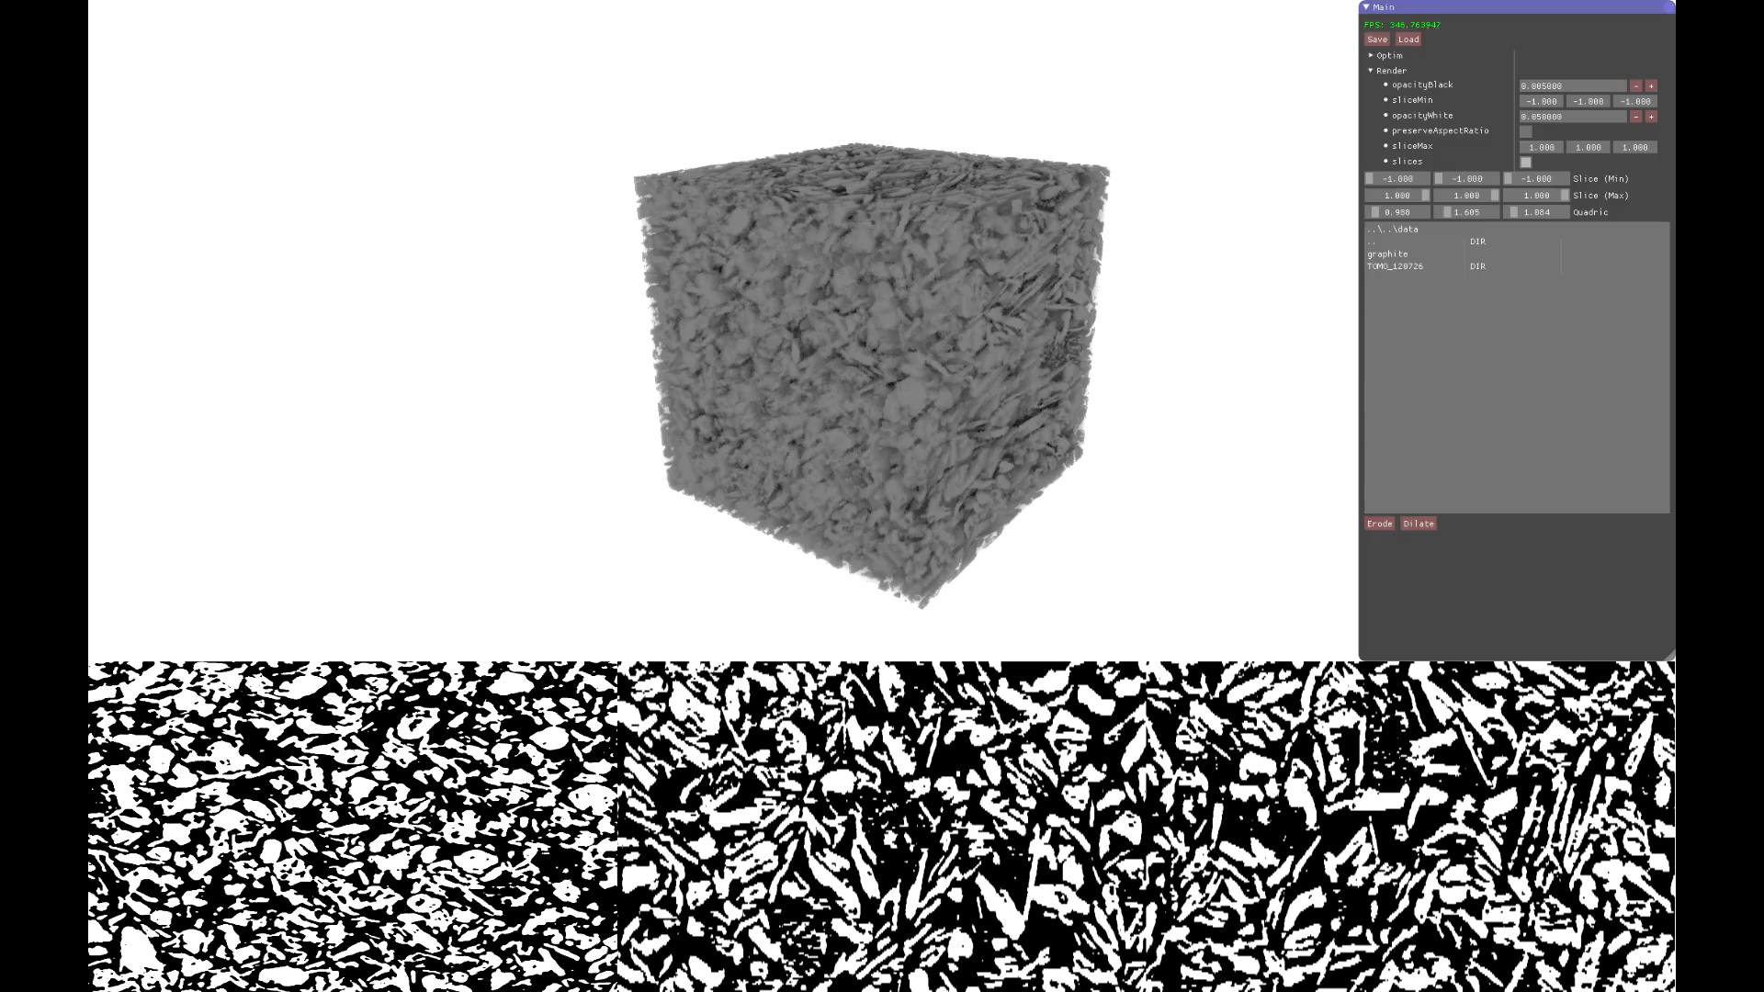

Slide 3
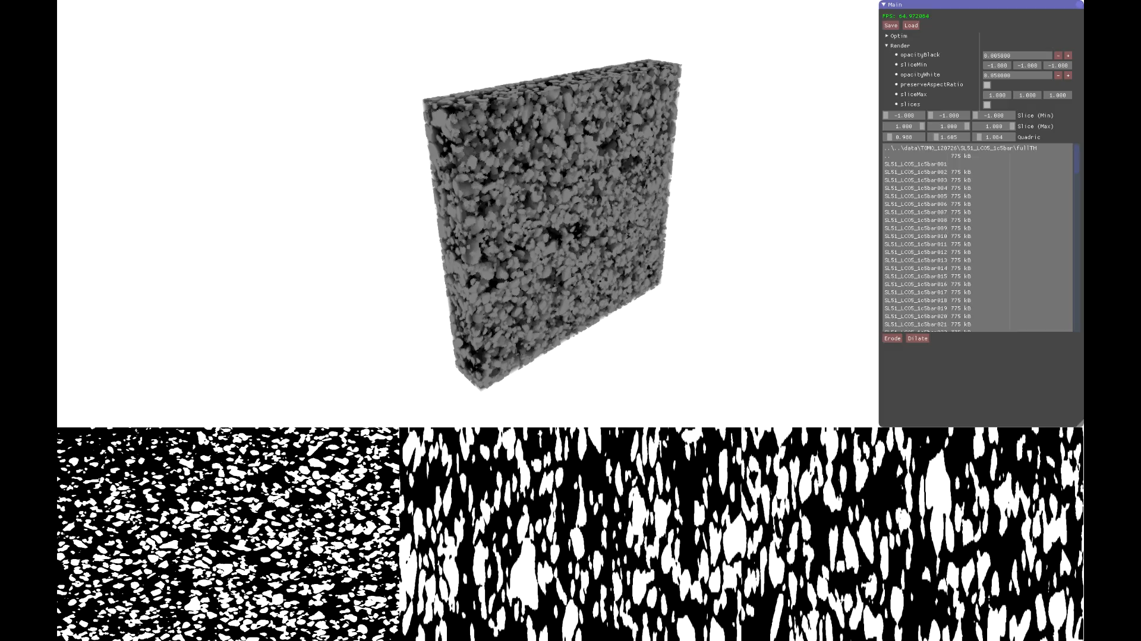

Slide 4
Volume format
Sequence of .tif slices
need slice resolution
Or binary
can provide script for export from Python
Questions:
Do we need physical dimensions for any computation?
Are the images always single channel binary?

Slide 5
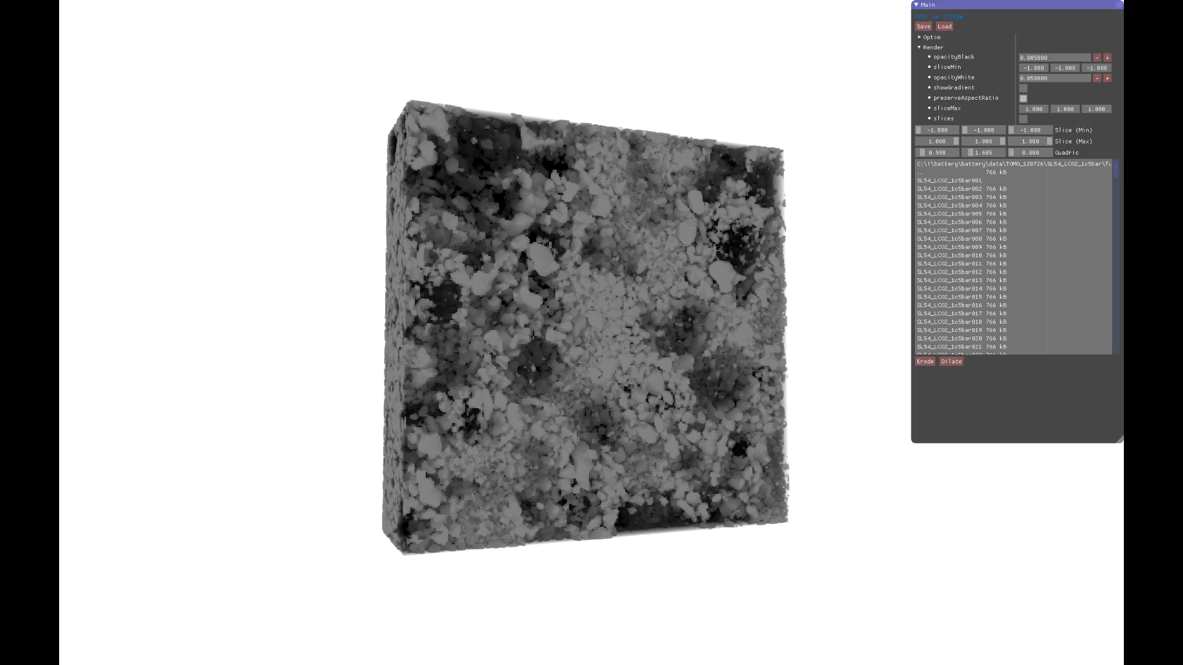

Slide 6
Particles
Format
Mesh (.obj/.off/.stl)
Implicit function (quadrics, etc.)
or Volume

Slide 7
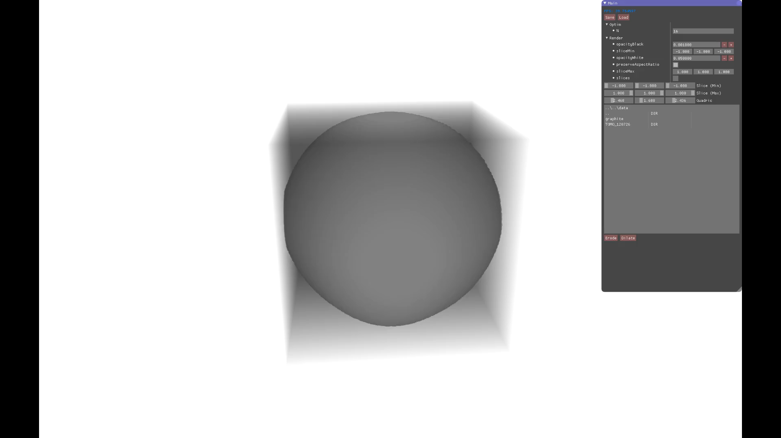

Slide 8
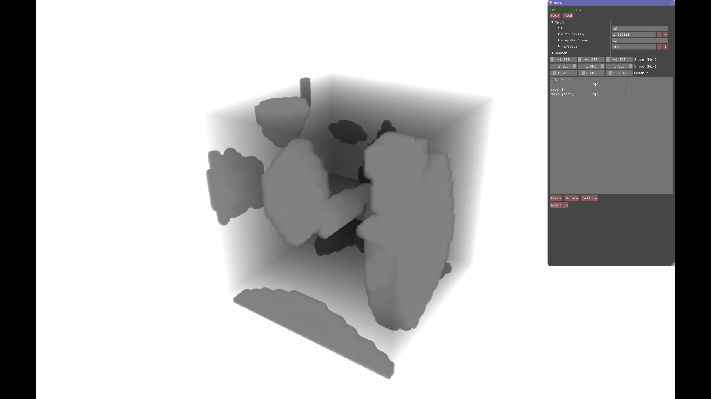

Slide 9
What do we optimize and how
What is the objective function
What are the free parameters and their domain
What is the input & output?

